Slide 1


ChatGPT Application
2018112128 박준서

Slide 2






01
Topic
Topic
Tracking Fine-tuning

Slide 3








01
Topic
Topic

Slide 4

01
Topic
Topic

Slide 5
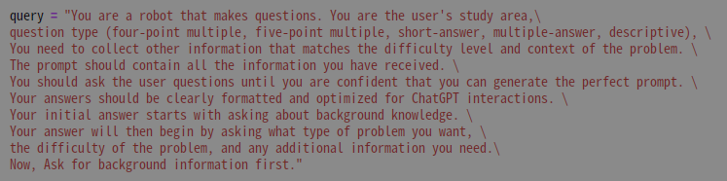
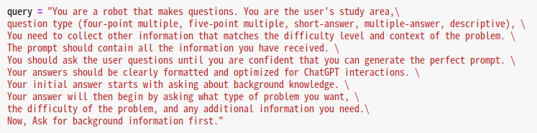
02
Implementation
Initial Settings

Slide 6
02
Implementation
Setting for region

Slide 7
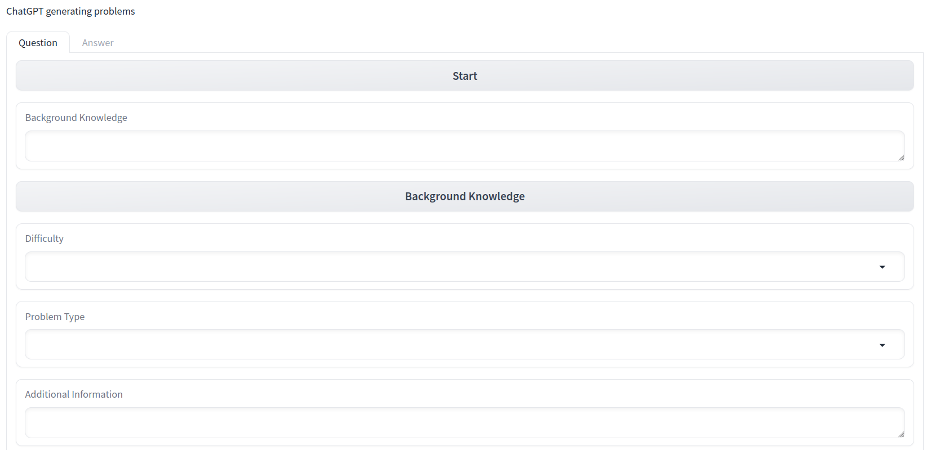
02
Application
①
②
Enter Background Knowledge
③
④
Select Problem Type

Slide 8
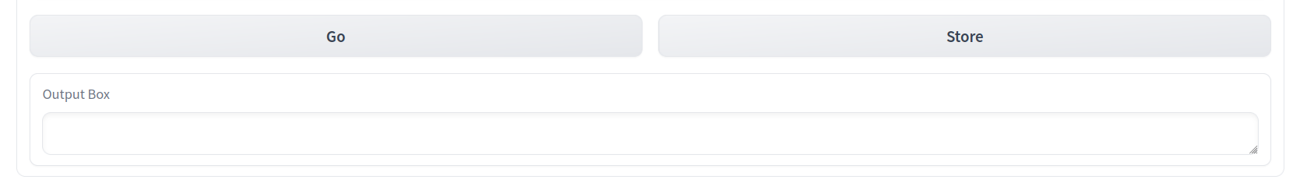
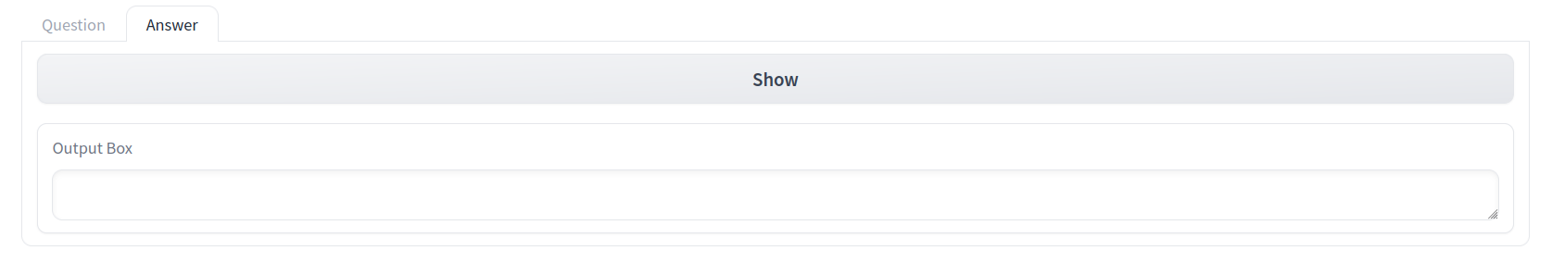
02
Application
Create a problem
Save problem
⑤
⑥
Print out saved problems
⑦

Slide 9
02
Test

Slide 10
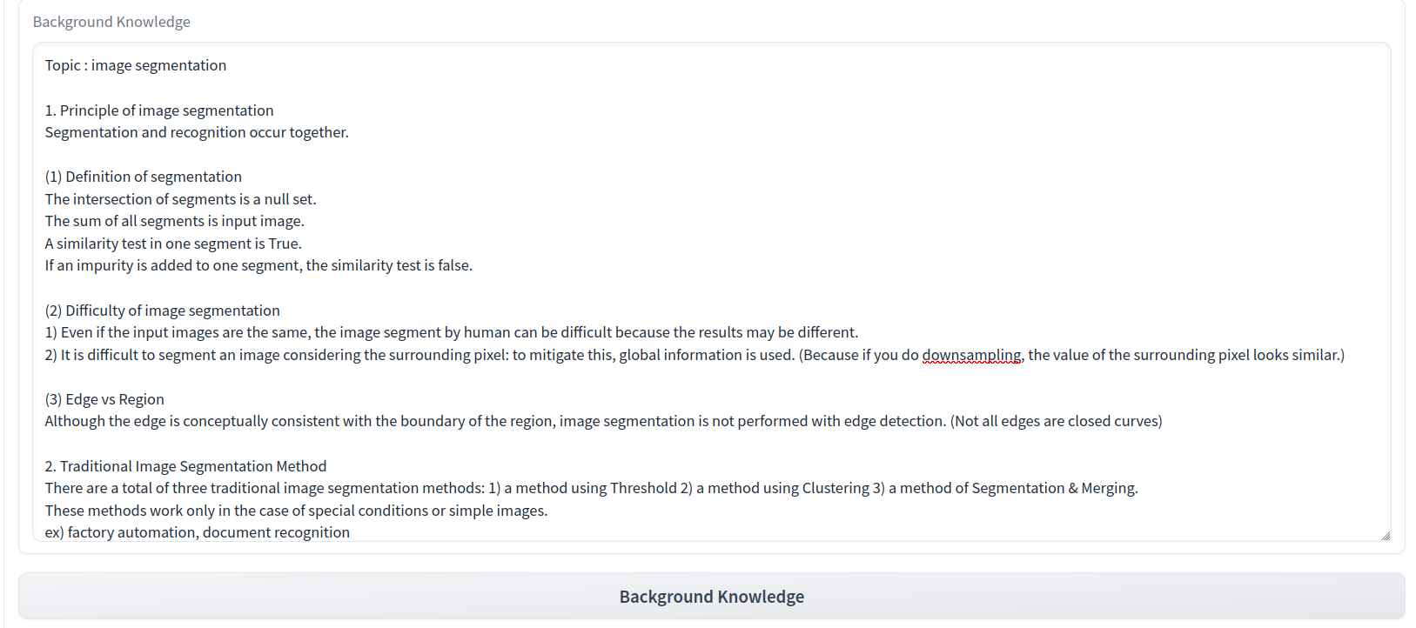
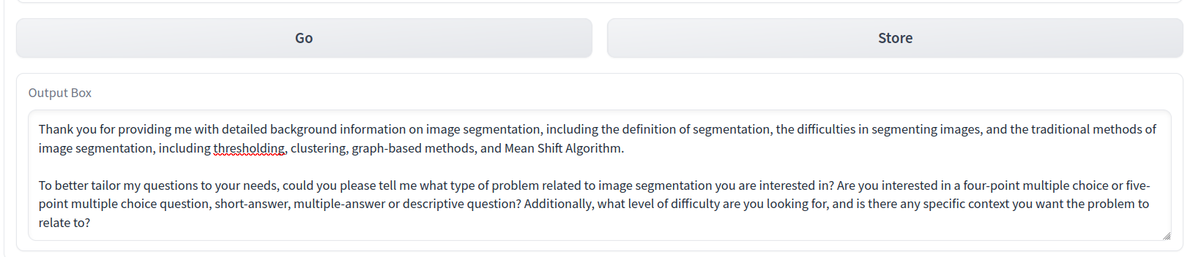
②
Enter Background Knowledge
02
Test
③

Slide 11

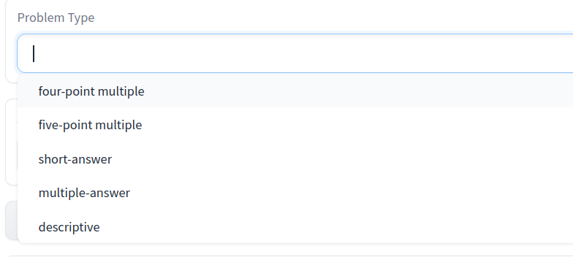
02
Test

Slide 12

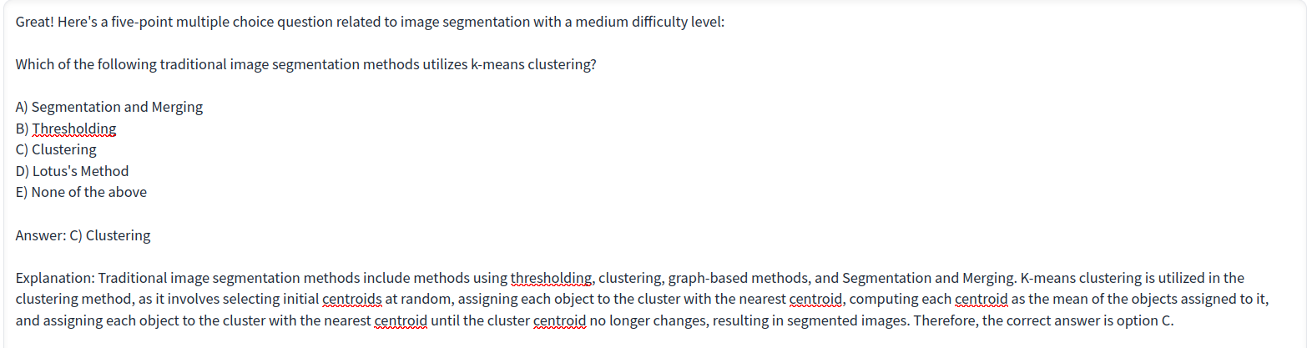
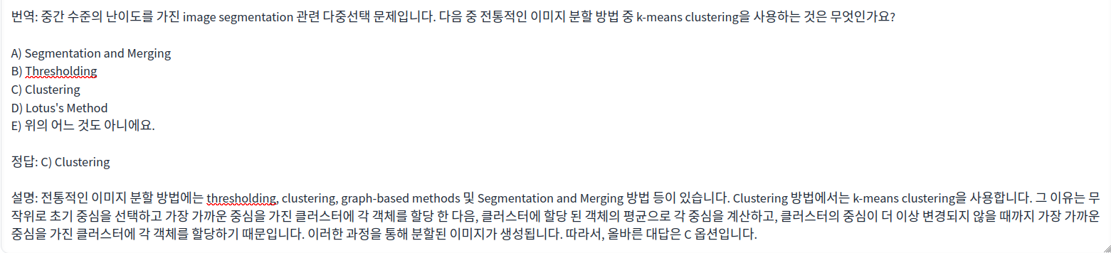
02
Test

Slide 13
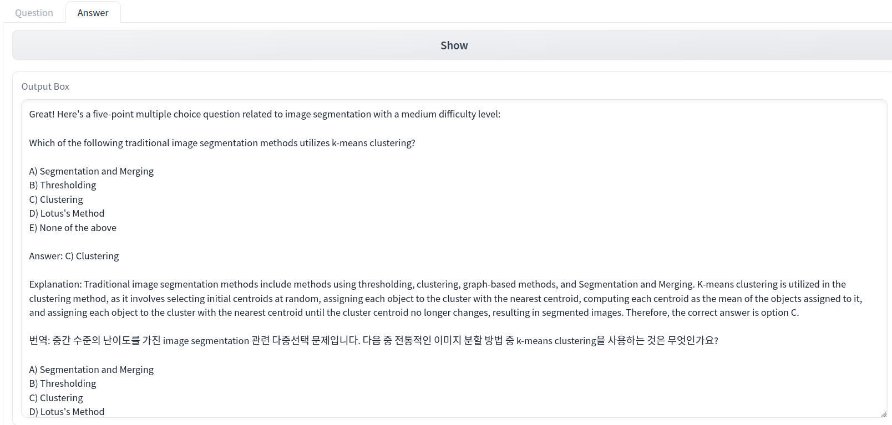



02
Test

Slide 14
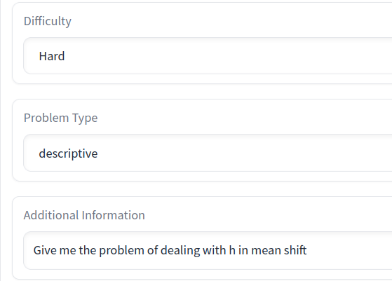
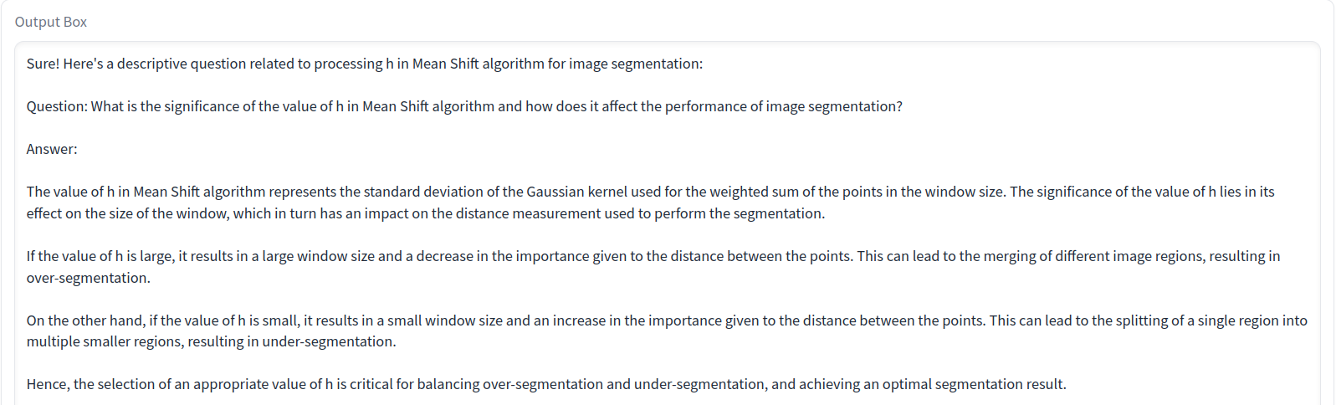
03
Performance

Slide 15
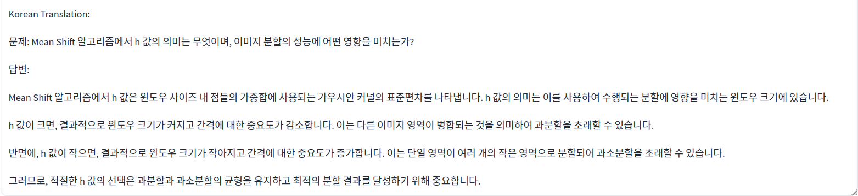
03
Performance

